Slide 1
An Introduction to PCA
1.Mathematics Foundation
2.Method and Proof
3.Application
4.PPCA
5.KPCA
6.RPCA
7.Conclusion
Motivation : dimension reduction

Slide 2
Mathematics Foundation
(Def) Statistical Values $\overline{x}=\frac{1}{n}\sum_{i=1}^{n}{x_{i}}$ $s^{2}=\frac{1}{n−1}\sum_{i=1}^{n}{{(x_{i}−\overline{x})}^{2}}$ $Cov(X,Y)=\frac{1}{n−1}\sum_{i=1}^{n}{(x_{i}−\overline{x})(y_{i}−\overline{y})}$
(Mean) correlation : +,-,0
(Def) Cov Matrix $Cov(X,Y,Z)=\left(\begin{matrix}Cov(X,X) & Cov(X,Y) & Cov(X,Z) \\ Cov(Y,X) & Cov(Y,Y) & Cov(Y,Z) \\ Cov(Z,X) & Cov(Z,Y) & Cov(Z,Z)\end{matrix}\right)$
(Def) Scatter Matrix $S=\sum_{k=1}^{n}{(x_{k}−m){(x_{k}−m)}^{T}}$ $m=\frac{1}{n}\sum_{k=1}^{n}{x_{k}}$
(Th) S=Cov×(total data value-1)
(Th) Normalization of Symmetrical Forms $A=Q\sum{Q^{−1}}$ $\sum{=}\left(\begin{matrix}λ_{1} & ⋯ & 0 \\ ⋮ & ⋱ & ⋮ \\ 0 & ⋯ & λ_{n}\end{matrix}\right)$
(Th) SVD $A=U\sum{V^{T}}$ $AA^{T}$for U $A^{T}A$ for V square root for
(Def+Th) Fronebius Norm ${\left\|A\right\|}_{F}=\sqrt{\sum_{i=1}^{m}{\sum_{j=1}^{n}{{\left|a_{ij}\right|}^{2}}}}=\sqrt{tr({\overline{A}}^{T}A)}=\sqrt{\sum_{i=1}^{min\{m,n\}}{{σ_{i}}^{2}}}$
(Def) Multivariate Normal Distribution $x\sim N(μ,\sum{)}$

Slide 3
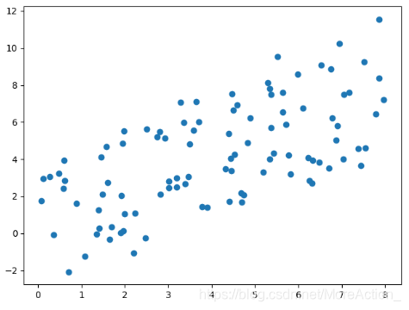
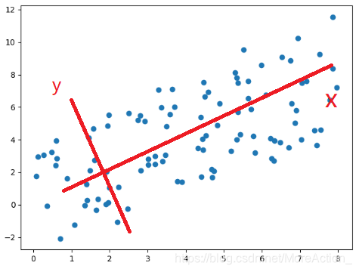




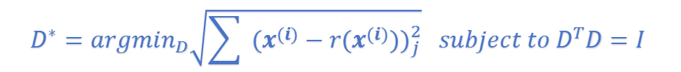

Proof:
Method and Proof
We know $k<n$.
Find a function f and a function g , s.t.
$$f:x∈R^{n}→c∈R^{k}$$
$$g:c∈R^{k}→x_{0}∈R^{n}$$
$$minimize {\left\|x_{0}−x\right\|}_{2}$$
Method:
How to reduce the
dimensions?
(simplify) Let there be a matrix D: $g(c)=Dc$
decentralization
All column vectors in D are orthogonal to each other and each has a unit norm.
Cov matrix
$$c^{∗}={argmin}_{c}{\left\|x−g(c)\right\|}_{2}$$
$$={argmin}_{c}{\left\|x−g(c)\right\|}_{2}^{2}$$
$$={argmin}_{c}{(x−g(c))}^{T}(x−g(c))$$
eigenvalue
compare
$$D^{T}D=I$$
eigenvector
$${argmin}_{c}(−2x^{T}Dc+c^{T}c)$$
P
row vector
$$∇_{c}(−2x^{T}Dc+c^{T}c)=0$$
$$c^{∗}=D^{T}x$$
$$y=Px$$
We define $r(x)≝g(f(x))=DD^{T}x$
We struct Confusion Matrix:
$C=(x^{(1)}−r(x^{(1)}) ⋯ x^{(n)}−r(x^{(n)}))$
Let Fronebius norm be smallest , then:
$$D^{∗}={argmin}_{D}\sqrt{\sum{{ (x^{(i)}−r(x^{(i)}))}_{j}^{2}}} subject to D^{T}D=I$$
i,j

Slide 4
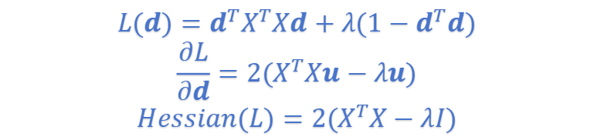

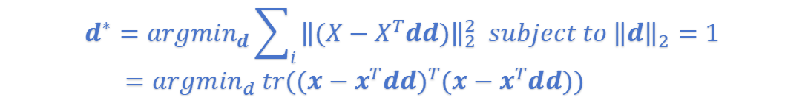




Using Mathematical Induction,we consider the situation of $k=1$.
$$\frac{∂L}{∂d}=0 \underset{⇒}{ } λ is the eigenvalue of X^{T}X$$
$$d^{∗}={argmin}_{d}\sum_{i}{{\left\|(x^{(i)}−dd^{T}x^{(i)})\right\|}_{2}^{2} subject to {\left\|d\right\|}_{2}=1}$$
It’s easy to find $X^{T}X$ symmetrical.
Therefore,We can use matrix diagonalization:
Taking $d^{T}x^{(i)}=x^{{(i)}^{T}}d$ into consideration,we have:
$$X^{T}X=Q^{−1}diag(X^{T}X)Q$$
$$d^{∗}={argmin}_{d}\sum_{i}{{\left\|(x^{(i)}−x^{{(i)}^{T}}dd)\right\|}_{2}^{2} subject to {\left\|d\right\|}_{2}=1}$$
Assuming $λ=λ_{max}$,we have:
We add all the points and have this formula :
$$Hessian(L)=2Q^{−1}(diag(X^{T}X)−λ_{max}I)Q$$
$$d^{∗}={argmin}_{d}\sum_{i}{{\left\|(X−X^{T}dd)\right\|}_{2}^{2} subject to {\left\|d\right\|}_{2}=1}$$
$={argmin}_{d} tr({(x−x^{T}dd)}^{T}(x−x^{T}dd))$
So Hessian(L) is negative semi-definite.
We can prove the maximum value is here to pick.
Using $d^{T}d=1,we have:$
If we want other features,then we can pick more eigenvalues and their related vectors.
$$d^{∗}={argmax}_{d} tr(d^{T}X^{T}Xd) subject to d^{T}d=1$$
$$\frac{∂tr(d^{T}X^{T}Xd)}{∂d}=0$$
How we evaluate our model:
$$Accuracy=\frac{\sum_{picked}{λ}}{\sum_{all}{λ}}$$
Using Lagrange multiplier method:
$$L(d)=d^{T}X^{T}Xd+λ(1−d^{T}d)$$
$$\frac{∂L}{∂d}=2(X^{T}Xu−λu)$$
$$Hessian(L)=2(X^{T}X−λI)$$

Slide 5
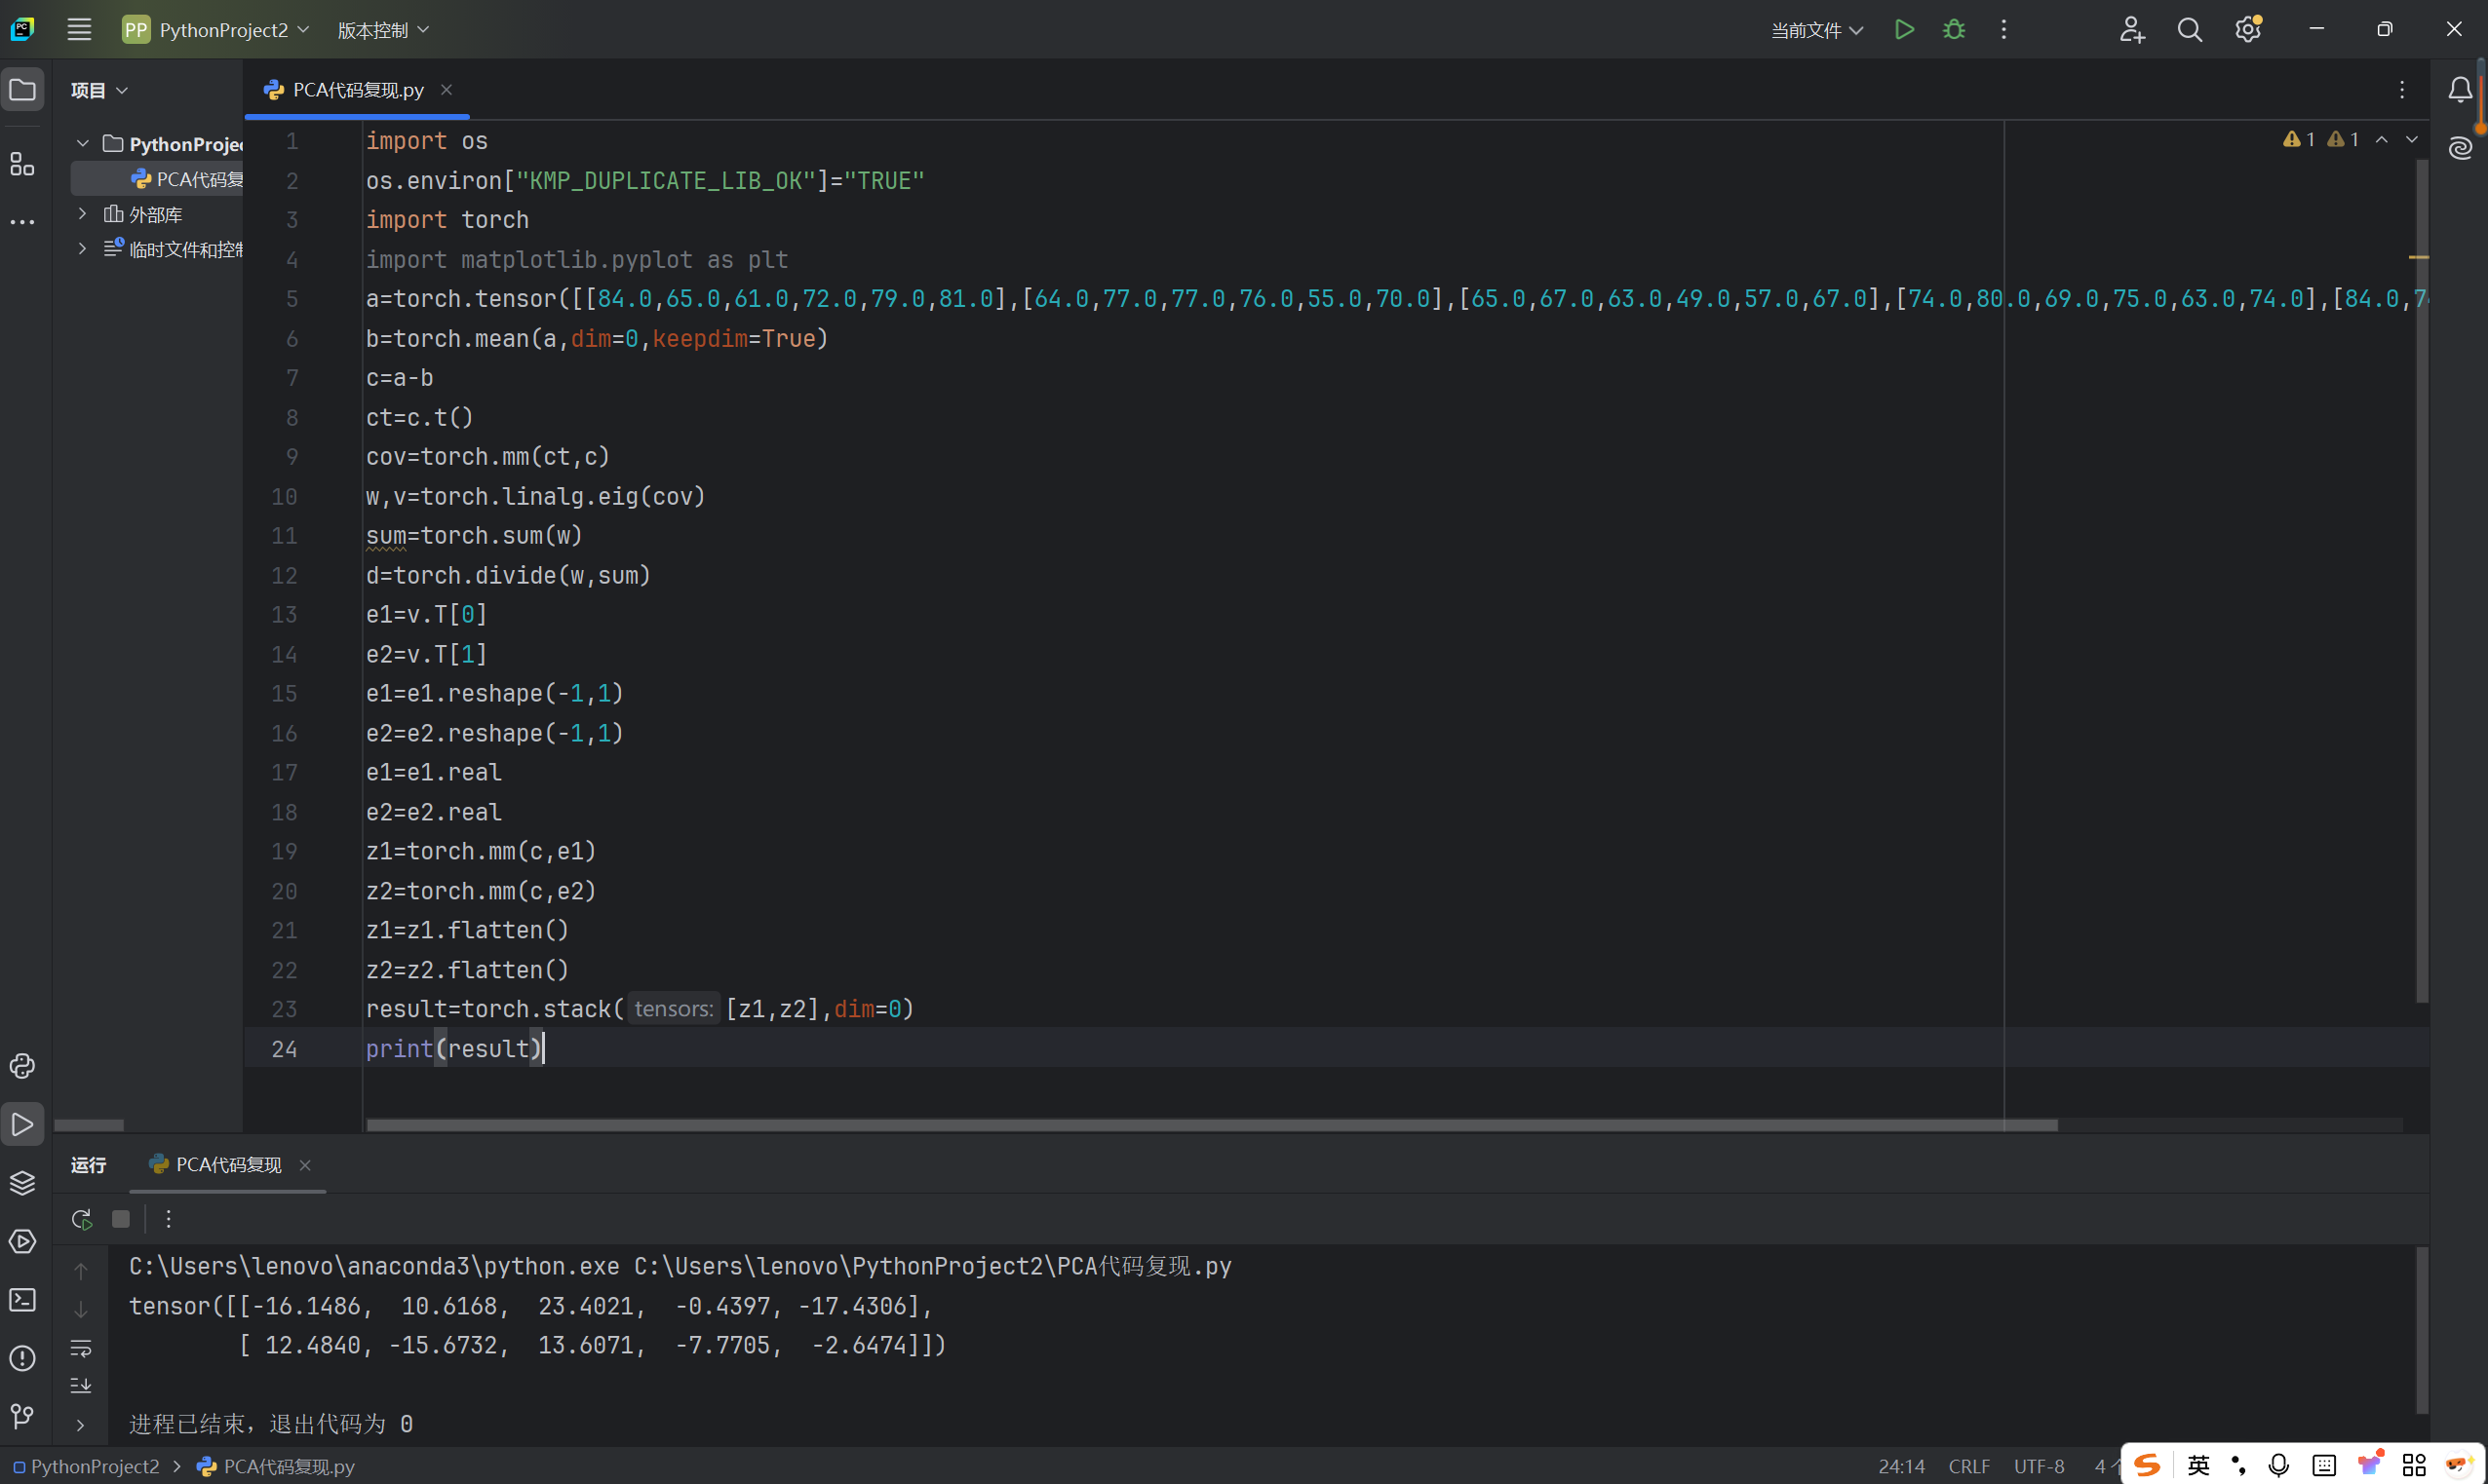
Application
Successful Recurrence Using Pytorch

Slide 6



PPCA
Boundedness of PCA:
Method | Assumption
PCA | $$x=Wz+μ$$
PPCA | $$x=Wz+μ+ε$$
1) hard to explain
2) noise processing
3) not precise
$$z\sim N(0,I_{d})$$
$$ε\sim N(0,σ^{2}I_{p})$$
$$x|z\sim N(0,σ^{2}I_{p})$$
$p(x)=\int{p(x|z)p(z)dz}={(2π)}^{\frac{−d−q}{2}}\frac{1}{σ}\int{exp(−\frac{1}{2}{(t−Wx−μ)}^{T}{(σ^{2}I)}^{−1}(t−Wx−μ)−\frac{1}{2}x^{T}x)dx}$
$={(2π)}^{\frac{−d−q}{2}}\frac{1}{σ}\int{exp(−\frac{1}{2σ^{2}}(x^{T}(σ^{2}I−W^{T}W)x−2{(μ−t)}^{T}Wx+{(t−μ)}^{T}(t−μ)))dx}$
Using $x^{T}Ax−2b^{T}x={(x−A^{−1}b)}^{T}A(x−A^{−1}b)−b^{T}Ab$
We finally have : $t\sim N(μ,σ^{2}I+WW^{T})$
Using Bayes' formula,we have :$x|t\sim N({(σ^{2}I+W^{T}W)}^{−1}W^{T}(t−μ),σ^{2}{(σ^{2}I+W^{T}W)}^{−1})$
Using MLE and EM,the final result is : $W=[\sum_{i=1}^{n}{(t_{i}−μ)E{(x_{i})}^{T}}]{[\sum_{i=1}^{n}{E(x_{i}x_{i}^{T})}]}^{−1}$
$$σ^{2}=−\frac{1}{nd}\sum_{i=1}^{n}{[{(t_{i}−μ)}^{T}(t_{i}−μ)+2E{(x_{i})}^{T}W^{T}(t_{i}−μ)−tr(W^{T}WE(x_{i}x_{i}^{T}))]}$$
Reference:https://andrewcharlesjones.github.io/journal/ppca.html

Slide 7
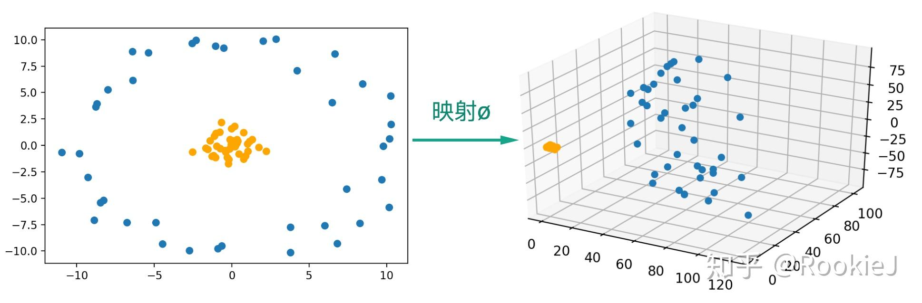




KPCA
Boundedness of PCA :
mapping
1) hard to divide in some situations (i.e. helix)
2) only for linear relationship
Input Space
We have $X=(x_{1} x_{2} ⋯ x_{n})∈R^{k×n}$
Find $φ(X)=(φ(x_{1}) φ(x_{2}) ⋯ φ(x_{n}))∈R^{k×D}$
$R^{D} is$Feature Space
easy to linearly divided
Due to PCA method,we need to solve the following function:
$$φ(X){φ(X)}^{T}p=λp$$
}
$${φ(X)}^{T}φ(X){φ(X)}^{T}φ(X)α=λ{φ(X)}^{T}φ(X)α$$
Based on the formula above,we have :$p=φ(X)α$
We define $K≝{φ(X)}^{T}φ(X)$
$$K·Kα=λKα$$
Its equivalent propositions is $Kα=λα$ (due to symmetry of K)
kernel trick: $K_{ij}={φ(x_{i})}^{T}φ(x_{j})$
kernel function: $k(x,y)≝{φ(x)}^{T}φ(y)$
Positive Definite Kernel
Polynomial Kernel: $k(x,y)={(x^{T}y+c)}^{d}$
Gaussian Kernel/RBF Kernel: $k(x,y)=exp(−\frac{{\left\|x−y\right\|}^{2}}{2σ^{2}})=exp(−γ{\left\|x−y\right\|}^{2})$
Sigmoid Kernel: $k(x,y)=tanh(ax^{T}y+r)$
> Mercer Kernel
When $λ=λ_{max}$:
We define eigenvector in this situation as $β.$
We have weight vector:
$$p=φ(X)β$$

Slide 8
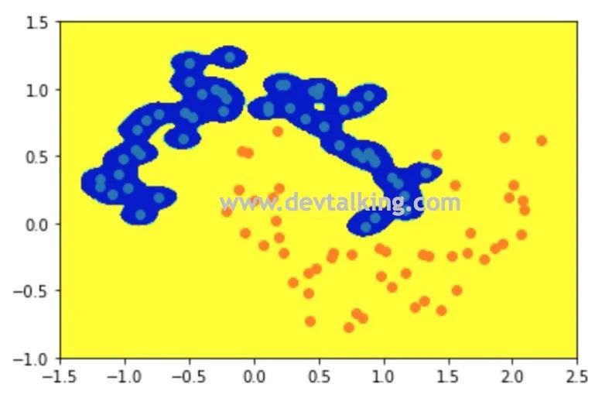
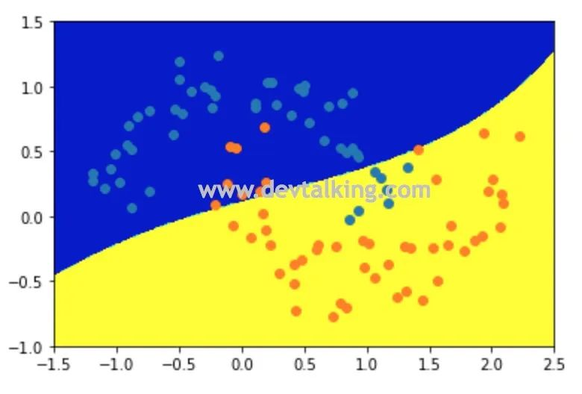










Solve this function:$Kα=λα$
Normalize: $p^{T}p=1$
$∴λα^{T}α=1$
Therefore,we just need to define$α:=\frac{α}{\sqrt{λ}}$
When $γ$ is large
overfitting
$φ(x_{i})$ casts its shadow on axis $p_{a}$ and there is:
$t_{ai}=\sum_{j=1}^{N}{α_{aj}K_{ij}}$
(PCA)
Gaussian kernel
$t_{a}=Cov·α_{a}=λ_{a−max}α_{a}$
$t_{a}=Kα_{a}=λα_{a}$
When $γ$ is small
Decentralization:
underfitting
We need to find $\tilde{φ}(x_{i})=φ(x_{i})−\frac{1}{N}\sum_{j=1}^{N}{φ(x_{j})}$
$1_{N×1}≝{(1 1 ⋯ 1)}^{T}$
$\tilde{φ}(x_{i})=φ(x_{i})−\frac{1}{N}φ(X)1_{N×1}$
$\tilde{φ}(X)=φ(X)−\frac{1}{N}φ(X)1_{N×1}1_{N×1}^{T}$
Steps:
$1_{N}≝\frac{1}{N}1_{N×1}{1_{N×1}}^{T}$
$$\tilde{φ}(X)=φ(X)−φ(X)1_{N}$$
Choose a kernel function and get matrix K
Using ${\tilde{K}}_{ij}=\tilde{φ}{(x_{i})}^{T}\tilde{φ}(x_{j})$,we have:
Calculate $\tilde{K}$
$\tilde{K}=K−K·1_{N}−1_{N}·K+1_{N}·K·1_{N}$
$y=\tilde{K}x$
Reference:https://zhuanlan.zhihu.com/p/59775730

Slide 9
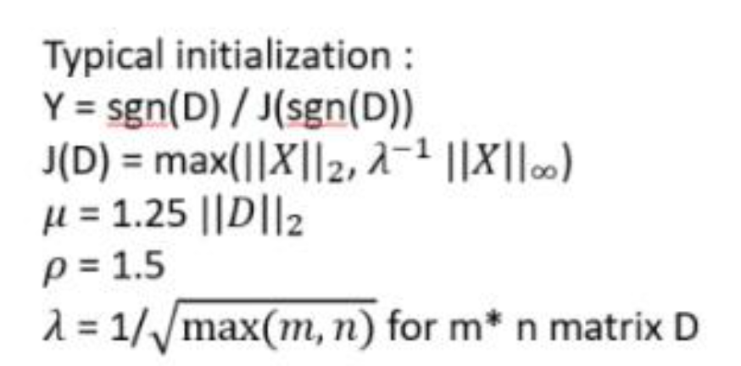
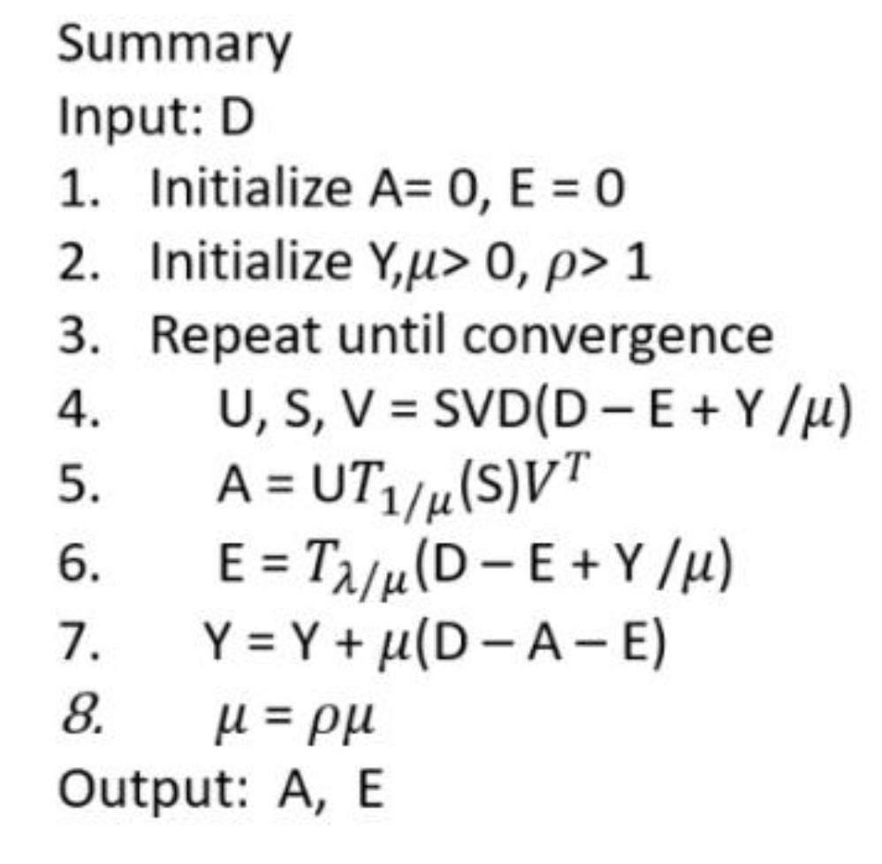

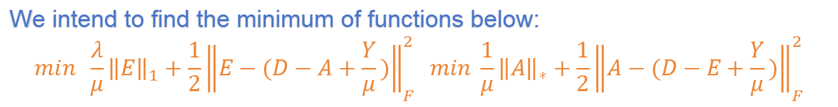
RPCA
Boundedness of PCA
Noise can be sparse and heavy.
Assumption
Convex optimization
Latent data have low rank while a small number of elements are polluted by noise.
$min rank(A)+λ{\left\|E\right\|}_{0} subject to D=A+E$
A,E
We approximately estimate LHS of the formula above:
$min {\left\|A\right\|}_{∗}+λ{\left\|E\right\|}_{1} subject to D=A+E$
A,E
We basically think of ALM:
We intend to find the minimum of functions below:
$$min \frac{λ}{μ}{\left\|E\right\|}_{1}+\frac{1}{2}{\left\|E−(D−A+\frac{Y}{μ})\right\|}_{F }^{2} min \frac{1}{μ}{\left\|A\right\|}_{∗}+\frac{1}{2}{\left\|A−(D−E+\frac{Y}{μ})\right\|}_{F}^{2}$$
A
E
We assume that $E=D−A+\frac{Y}{μ}.$
A
Soft Threshold Operator:
$T_{ε}(x)=\left\{\begin{aligned}x−ε if x>ε \\ x+ε if x<ε \\ 0 otherwise\end{aligned}\right.$
Then we have the following formula:
$E=T_{λ/μ}(D−A+\frac{Y}{μ})$
$A=UT_{1/μ}(S)V^{T}$
singular value degradation+the obtained matrix=low rank

Slide 10
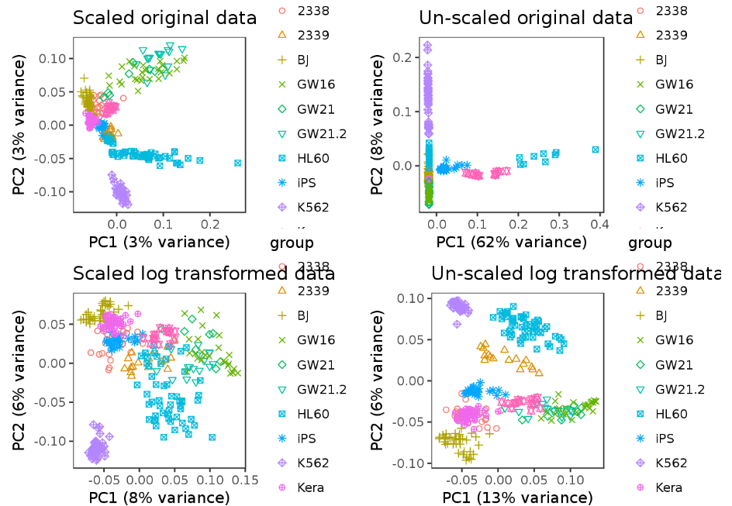
Conclusion
In Chinese I take these methods into a sentence:
去中心，找参矩，求特征，得结果.
PCA | linear,black-box
PPCA | noise,explainatory
KPCA | non-linear
RPCA | sparse or heavy noise
Preprocessing
I’ve also learned about what surplus mathematics base I need:
Convex Optimization,Matrix Theory,Functional Analysis
However,there are problems such as fuzzy assumptions,time complexity not proved best,and so on.Therefore,further analysis on that is a must.

